Slide 1

Defense Security Service
Risk Management Framework (RMF)
May 2017

Slide 2
Goals of the Presentation
Review terminology/resources for RMF
Set expectations for completing documentation
Provide examples for discussion
Address Authorization requests via OBMS
Discuss Security Controls Assessor (SCA) Visit to the facility

Slide 3
RMF Basics
What is Risk Management Framework (RMF)?
    A unified information security framework for the entire federal government that replaces legacy Certification and Accreditation (C&A) processes applied to information systems (ISs).
    A key component of an organization’s information security program used in the overall management of organizational risk.
When will RMF replace C&A (Phased Implementation)?
    RMF has already replaced C&A for Stand-Alone systems as of October 3, 2016. Multi-User Standalones (MUSA) and Single-User Standalones (SUSA) were required to execute the RMF process for any expiring C&A accreditations and new submittals.
    The Transition date for Local Area Networks (LAN) and Wide Area Networks (WAN) is tentatively set for January 1, 2018.
    (You can submit RMF plans prior to the start date)

Slide 4
Here is the way some people see things
NIST SP-800-53r4
SCAP Compliance Checker
DOD 5220.22-M (NISPOM)
DSS In Transition
NIST SP-800-37
NIST SP-800-30
DISA STIGs
System Assessment Report (SAR)
Terminology/Resources
NIST SP 800-60
Continuous Monitoring
DAAPM
Risk Assessment Report (RAR)
CNSSI-1253
NIST SP 800-61
www.dss.mil/rmf
SSP Appendices
SSP
CDSE Training on RMF
NIST SP-800-137
NIST SP 800-53A
ISSM Certification Statement
Notes:
The amount of terminology and available reference material can sometimes feel overwhelming. This presentation will attempt to help put things in perspective.

Slide 5
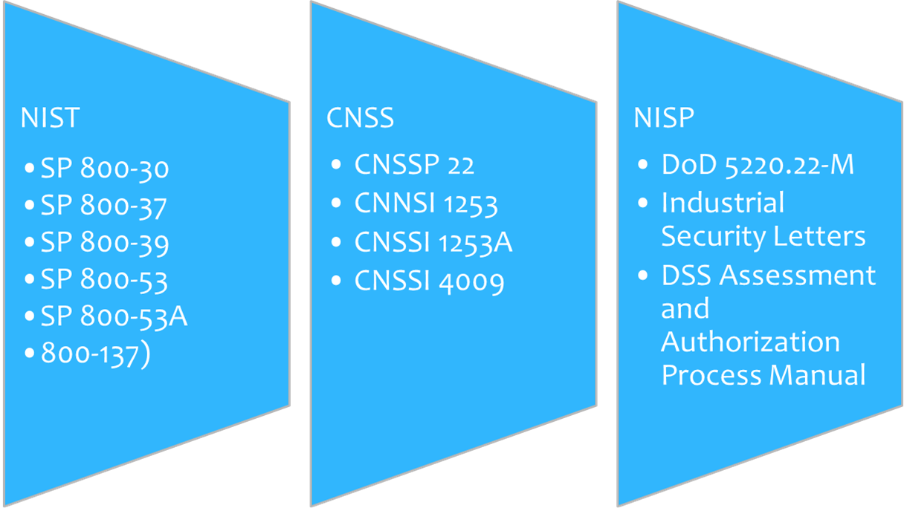
RMF Policy References
Local Area Network, Wide Area Network or Interconnected System between August 1, 2016 – 28 February 2017

Slide 6
Planning Guidance/Resources
NISPOM- DOD 5220.22-M, Dated February 2006 (with change 2 dated May 18, 2016)
Basic starting point for cleared contractors to implement RMF (NISPOM 8-100.d)
DAAPM- DSS Assessment and Authorization Process Manual, Dated August 24, 2016
Basic guidance for requesting the authorization of an information system
for classified Government work.
CDSE RMF Training- There are 7 courses that ISSMs are required to complete to get an
Overall understanding of RMF (see “ISSM Required Online Training” in the DAAPM).
www.dss.mil/rmf- One stop website for many tools and templates needed for RMF
NIST SP-800-37 (rev 1) - Guide for Applying the Risk Management Framework to Federal Information Systems, dated February 2010 (with June 2014 updates)
NIST SP-800-30 (rev 1)- Guide for Conducting Risk Assessments, dated September 2012
NIST SP 800-60 (vol 1-2)- Guide for mapping information to categories, Dated August 2008
NIST SP-800-53 (rev 4)- Security and Privacy Controls for Federal Information Systems
and Organizations, Dated April 2013 (with Jan 2015 updates)
NIST SP 800-61 (rev 2)- Computer Security Incident Handling Guide, Dated August 2012
CNSSI-1253 Security Categorization and Control Selection for National Security Systems,
Dated March 27, 2014

Slide 7
Security Controls and Continuous Monitoring
The RMF process will manage risk more effectively through the introduction of security controls and continuous monitoring of those controls.
Purpose of Security Controls and Continuous Monitoring | Benefits of Security Controls and Continuous Monitoring
Assess security control effectiveness for an IS Document changes to the IS or its environment of operation Conduct security impact analyses of associated changes Report the security status of an IS | Facilitate more efficient enterprise management of cybersecurity Increase security in the system development and acquisition processes Ensure compliance with national standards and reporting requirements
National Industrial Security Program Operating Manual (NISPOM)
NIST SP 800-37: Guide for Applying the Risk Management Framework to Federal Information Systems
NIST SP 800-53: Security and Privacy Controls for Federal Information Systems and Organizations
NIST SP 800-137: Information Security Continuous Monitoring (ISCM) for Federal Information Systems and Organizations
NIST SP 800-53A: Assessing Security and Privacy Controls in Federal Information Systems and Organizations: Building Effective Assessment Plans
Committee on National Security Systems Instruction (CNSSI) 1253: Security Categorization and Control Selection for National Security Systems
Resources to assist in the RMF Process
Many additional resources can be found on the NIST website (www.nist.gov)

Slide 8
RMF Process Stakeholders – New Terminology
Many RMF stakeholder titles have been revised in the transition from C&A. The following table outlines former terms in the C&A process as well as the corresponding new terms in the RMF process. Both sets of terms will continue to be used during the transition to RMF.
Old Term in the C&A Process | New Term in the RMF Process
Designated Approving Authority (DAA) | Authorizing Official (AO)
Regional Designated Approving Authority (RDAA) | Regional Authorizing Official (RAO)
Office of the Designated Approving Authority (ODAA) | NISP Authorization Office (NAO)
Information Systems Security Professional (ISSP) | ISSP/Security Control Assessor (SCA)
Customer, Government Contracting Activity (GCA) | Information Owner (IO)
Contractor | Information System Owner (ISO)
*Information Systems Security Manager (ISSM) | ISSM
*Information Systems Security Officer (ISSO) | ISSO
*Titles will remain the same in RMF.

Slide 9
Connecting the Dots –
What is Changing? What is staying the same?
Process | C&A | RMF
ODAA Business Management System (OBMS) | Same | Same
System Security Plan (SSP) Template | C&A Template | RMF Template
Categorization | Basic, Med, High PLs | Low, Mod, High Accessibility
Certification Statement | Same | Same
Risk Acknowledgement/Tailoring-out | Risk Acknowledged | Tailored-Out/Risk Acknowledgement
MOU | MOU | MOU/ISA
Standing-Up Like System | Self- Certification | Type Authorization
Controls | NISPOM Refs | NIST Controls
Approval to Process | Accreditation | Authorization

Slide 10
Connecting the Dots –
What is Changing? What is staying the same?
Process | C&A | RMF | OBMS File Designation
Submit Artifacts within OBMS | SSP Certification Statement Profile | SSP Certification Statement Risk Assessment Report POA&M SSP Supporting Artifacts (appendices) | SSP Security Package Submission and Certification Statement IS Profile Other Other
Issues Related to Authorization | Comments Form Accreditation Letter | Comments form used to concur with categorization/controls Terms & Conditions in Authorization Letter
Notes:
Remember that all files loaded into OBMS must be pdf files.
Items in “red” are required by OBMS or the submitter will get an error

Slide 11
RMF Process Walk Through: Introduction
Starting Point
1. CATEGORIZE Information System
ISSM conducts risk assessment to determine system categorization (confidentiality, integrity, and availability).
6. MONITOR
Security Controls
2. SELECT Security Controls
ISSM continuously tracks and reports IS changes to the ISSP IAW the Continuous Monitoring Plan/Strategy.
ISSM selects security controls and applies tailoring and supplemental controls as needed based on risk assessment. ISSP reviews SSP and provides concurrence.
NISP Assessment & Authorization Life Cycle
5. AUTHORIZE Information System
3. IMPLEMENT Security Controls
AO determines risk.
If acceptable, AO formally authorizes system to operate.
ISSM implements security controls selected for the IS.
4. ASSESS
Security Controls
ISSM conducts self-assessment and updates the SSP to reflect the actual state of the IS. ISSP reviews submitted SSP and assesses the IS.
Notes:
The highlighted steps is where the most DSS involvement will be.

Slide 12
CDSE Training Courses
RMF Courses
      Introduction to RMF (CS124.16)
      Continuous Monitoring (CS200.16)
      Categorization of the System (CS102.16)
      Selecting Security Controls (CS103.16)
      Implementing Security Controls (CS104.16)
      Assessing Security Controls (CS105.16)
      Authorizing Systems (CS106.16)
      Monitoring Security Controls (CS107.16)

Slide 13
RMF Process Walk Through -
STEP 1: Categorize the IS
ISSM Actions:
Categorize the Information System (IS) based on the impact due to a loss of Confidentiality, Integrity, and Availability of the information that will be processed.
(Note: The DSS SSP template is based on a Moderate Confidentiality, Low Integrity, and Low Availability Impact. Make sure you haven’t been contractually required to address different Impact Levels)
Perform a Risk/Threat Assessment and ensure a Risk Assessment Report (RAR) is completed.
(Note: Seek information from all available sources (e.g., Government Customer/Information Owner, Program Managers, Local service risk/threat developed documents)
Document the system description, including the system/authorization boundary, in the System Security Plan.
Assign qualified personnel to RMF roles and document team member assignments in the SSP.
Output(s): Risk Assessment Report, Initial System Security Plan
Reference(s): NIST SP 800-30 rev 1, NIST SP 800-60, CNSSI 1253, DAAPM

Slide 14
RMF Step 1 – Risk Assessment Report (RAR)
What guide is used when conducting a Risk Assessment?
    NIST 800-30 Rev 1, Guide for Conducting Risk Assessments
What is the purpose of the RAR?
    Inform decision makers and support risk responses by identifying:
      Relevant threats
      Vulnerabilities both internal and external to the organization
      Impact to the organization that may occur given the potential for threats exploiting vulnerabilities
      Likelihood that harm will occur
    The end result is a determination of risk.
    The RAR will be used to “fine tune” security controls for the life of the system

Slide 15
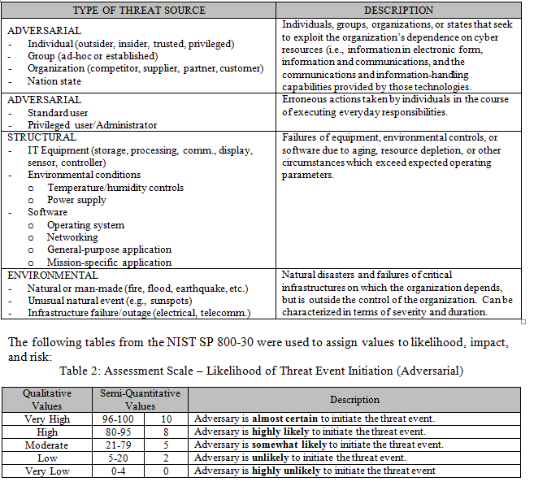
RMF Step 1 – Risk Assessment Report (RAR)

Slide 16
RMF Process Walk Through –
Step 2-1 through 2-3: Selecting Security Controls
ISSM Actions:
Select the security controls applicable to the IS. The selection is based upon the results of the categorization (which is impacted by the RAR).
(Controls for Moderate/Low/Low impact are included in the DSS SSP Template)
Tailor the controls as needed by supplementing, modifying, or tailoring out controls to effectively manage risk for any unique system conditions.
Develop a strategy for continuous monitoring of security control effectiveness.
Document the security controls selection results in the SSP.
Output(s): Initial System Security Plan
Reference(s): NIST SP 800-53 rev 4, CNSSI 1253, DAAPM (appendix A, D)

Slide 17
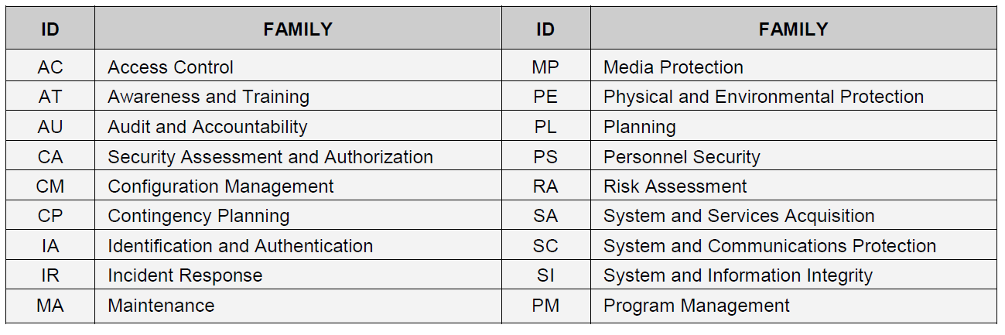
Security Controls Summary- NIST
112
22
10
50
58
10
22
15
50
13
48
86
56
116
34
82
26
16
826 Individual Controls from 18 “families” according to NIST SP-800-53r4

Slide 18
Security Controls Summary- DSS Appendix D
57
17
7
21
30
8
11
12
25
9
7
22
28
51
24
31
11
15
386 Individual Controls from 18 “families” according to DAAPM- App-D

Slide 19
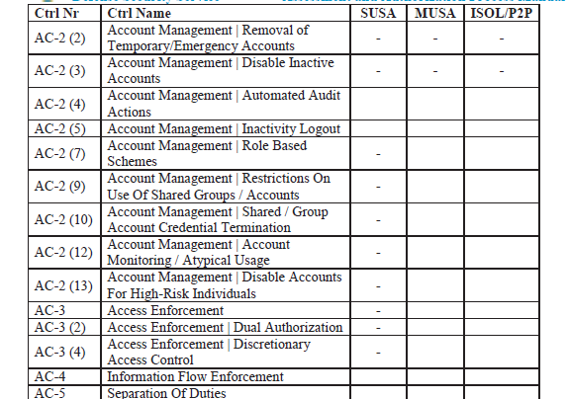
Security Controls – Overlays (DAAPM, App D.)

Slide 20
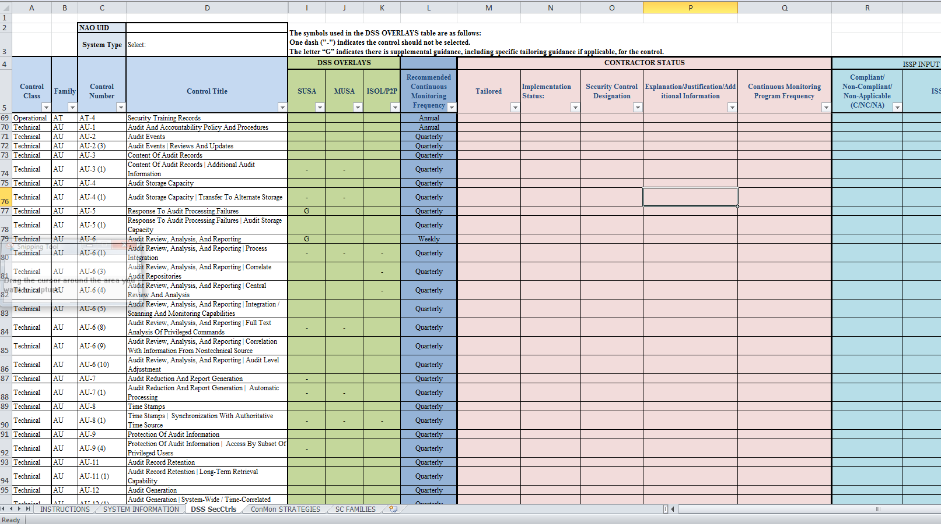
Control Selection Using Excel
A Spreadsheet is available at www.dss.mil/rmf . This would need converted to a PDF for input into OBMS

Slide 21
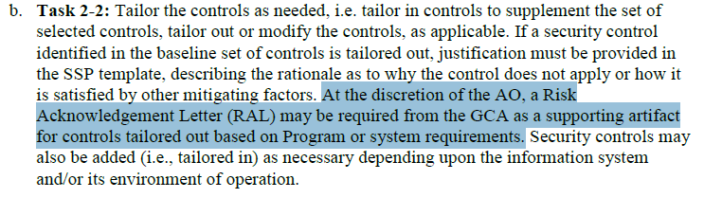
Now you are done selecting controls, but remember…
Notes:
You may be asked to coordinate a RAL with the Information Owner if items tailored out are not already included in the RAR.

Slide 22
RMF Process Walk Through –
Step 2-4: Submit Security Controls/ Categorization
Now at this point….
Risk Assessment Report (RAR) is complete
Starting Point
Categorization is complete
1. CATEGORIZE Information System
Control Selection is complete
ISSM conducts risk assessment to determine system categorization (confidentiality, integrity, and availability).
6. MONITOR
Security Controls
2. SELECT Security Controls
ISSM continuously tracks and reports IS changes to the ISSP IAW the Continuous Monitoring Plan/Strategy.
ISSM selects security controls and applies tailoring and supplemental controls as needed based on risk assessment.
ISSP reviews SSP and provides concurrence.
NISP Assessment & Authorization Life Cycle
5. AUTHORIZE Information System
3. IMPLEMENT Security Controls
AO determines risk.
If acceptable, AO formally authorizes system to operate.
ISSM implements security controls selected for the IS.
4. ASSESS
Security Controls
ISSM conducts self-assessment and updates the SSP to reflect the actual state of the IS. ISSP reviews submitted SSP and assesses the IS.
Notes:
We are still in Step 2 of the RMF process and the ISSM has just completed the RAR, The system categorization, and the selection of controls (identified by the boxed area. The question is now how do you get that to DSS?

Slide 23
RMF Process Walk Through –
Step 2-4: ISSM Submits Step “2” work via OBMS
Use OBMS to submit initial documents.
    Submit the SSP in OBMS as the “SSP”
    Submit the Risk Assessment Report (RAR) as the “IS Profile”
    Submit a “blank” Certification Statement as the “Security Package Submission and Certification Statement”
    Submit other necessary artifacts as “other”
    (Note: There is a “SSP appendices” document that can be used for things like the POA&M, DD-254, etc.)
    Remember that all documents in OBMS must be .pdf

Slide 24
RMF Process Walk Through –
Step 2-4: DSS Response to Controls/Categorization
ISSP/SCA Actions:
Review the initial SSP and RAR to ensure it meets the necessary security requirements and effectively identifies potential risks to the IS. The ISSP/SCA also reviews the ISSM-recommended deltas from the standard baseline.
Documents concurrence or non-concurrence in the Categorization & Implementation Concurrence Form.
Categorization & Implementation Concurrence Form is returned to ISSM via OBMS.
(Note: This is done with a new form, but the “comments” drop down is used in OBMS.)
Output: DSS Categorization & Implementation Concurrence Form
The ISSP/SCA is focusing their review on the Categorization of the IS and the Selection of controls and will only comment on detailed supporting information if time permits.

Slide 25
RMF Process Walk Through –
Step 2-4: ISSM Response to DSS “step 2” review
ISSM Actions:
If concurrence for both categorization and selection of initial baseline controls is issued, proceed to RMF Step 3.
If non-concurrence is issued, address outstanding issues documented in Categorization & Implementation Concurrence Form. Once issues are addressed, resubmit the RAR and initial SSP via OBMS.
Output(s): Initial SSP with identified controls, Continuous Monitoring Strategy, RAR, and Categorization & Implementation Concurrence Form

Slide 26
RMF Process Walk Through –
Step 3: Implement Security Controls
ISSM Actions:
Implement security controls as determined/documented in RMF Step 2.
Revise the SSP in order to document the security control implementation.
Start a Plan of Action and Milestones (as applicable).
Conduct an initial assessment to facilitate early identification of weaknesses and deficiencies.
Document (or update as necessary) the security control implementation in the SSP.
Output: Updated SSP with a complete functional description of security control implementation.
Reference(s): CNSSI 1253, NIST SP 800-53, and DAAPM (Appendix A & D)

Slide 27
RMF Process Walk Through –
Step 4: Assess Security Controls
ISSM Actions:
Conduct an initial assessment of the effectiveness of the security controls in accordance with the security procedures defined in the SSP.
Utilize the Defense Information System Agency (DISA) vulnerability scanning tools (SCAP Compliance Checker and DISA STIG Viewer) and the DSS Technical Assessment Job Aids to support the initial assessment. If the IS cannot be assessed utilizing the specified scanning tools, please document the justification in the SSP.
Finalize the SSP to reflect the actual state of the security controls, as required, based on the vulnerabilities of the security control assessment, reassessment, and completion of any remediation actions taken.
Submit the final SSP, signed Certification Statement, RAR, POA&M, and supporting artifacts via OBMS.
Artifact(s): Final SSP, singed Certification Statement, RAR, POA&M, and SSP Supporting Artifacts Reference(s): NIST SP 800-53A, DAAPM, www.dss.mil/rmf

Slide 28
RMF Process Walk Through –
Step 4: Assess Security Controls- Assessment Tools
The following tools are helpful :
SCAP Content Checker (SCC)- This tool (developed for SPAWAR) allows you to compare your system configuration to a “defined” standard (typically called a “benchmark”).
DISA STIG Viewer- This is a DISA application used to view various “Security Technical Implementation Guide (STIG) content
DISA STIG Content
      Complete Comprehensive STIG
      Benchmarks
      IAVMs- Information Assurance Vulnerability Management….i.e., Patching
      STIG Checklists
Output: Confirmation that controls have been properly implemented, Checklists, etc..
Reference(s): http://iase.disa.mil/stigs/Pages/index.aspx#
NOTE: Some DISA Content is PKI encrypted which can present some difficulty for Contractors.
Notes:
ISSM are encouraged to use available tools to aid with their assessment of the implemented controls. These tools are not mandatory, but they will be used by the SCA during the onsite review.

Slide 29
RMF Process Walk Through –
Step 4: Assessment Tools-Windows 7 Example
Technical & Manual Checks
The STIG Viewer is used to create a checklist of 300
Overall STIG Items
The SCC can analyze 254 Windows 7 automated computer settings based on a Windows 7 STIG Benchmark (V1R31)
XCCDF results file is created and imported into the overall checklist.
Remaining 46 Items need to be manually assessed
An IAVM STIG checklist can be generated to view 493 Vulnerabilities (as of 12-23-2016) to confirm Patch implementation
Notes:
Here is an overall diagram related to the possible review of a Windows 7 computer. You can review the 278 technical settings either manually or in an automated fashion with the SCC and then evaluate the other items manually

Slide 30
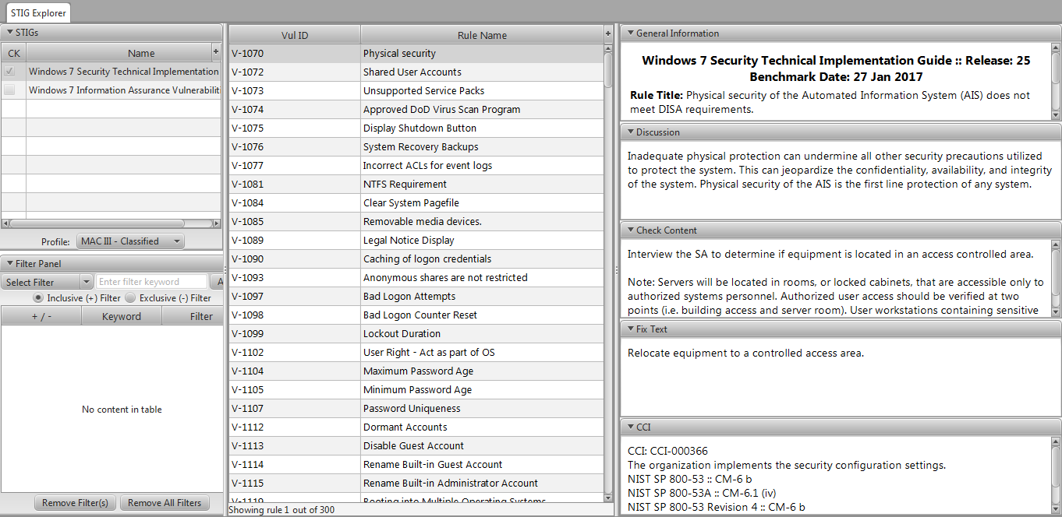
RMF Process Walk Through –
Step 4: Assessment Tools- STIG Viewer
Sign up to get notified about STIG updates…
A guide for the STIG viewer (Now at version 2.5.1) is located at….http://iase.disa.mil/stigs/Pages/stig-viewing-guidance.aspx
Notes:
This STIG viewer can be used to view STIG content from many different areas. You can view Benchmarks, IAVMs, or overall STIG content.

Slide 31
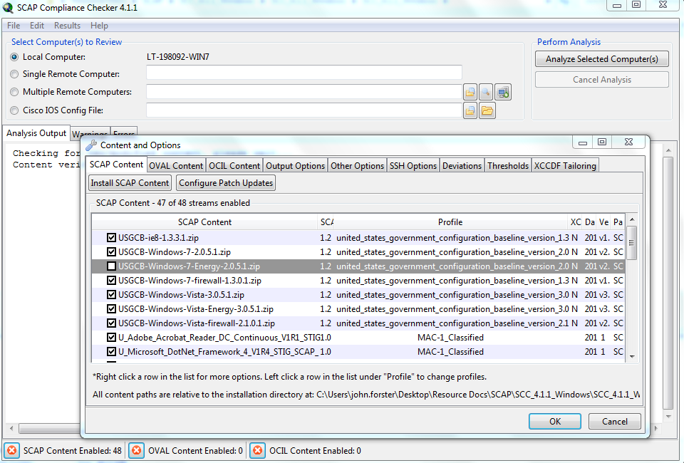
RMF Process Walk Through –
Step 4: Assessment Tools- SCC Tool
Notes:
Here is an example of what the SCAP Compliance Checker (SCC) looks like. The tool can be used in conjunction with many different benchmarks. This can include benchmarks that relate to the Operating System software and various Application software.

Slide 32
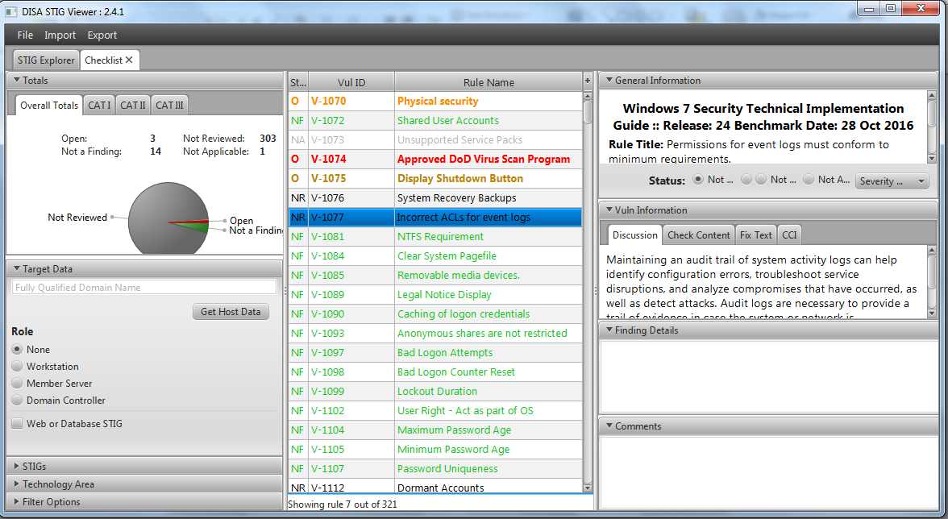
RMF Process Walk Through –
Step 4: Assessment Tools- STIG Checklist
Notes:
This is what a typical STIG checklist will look like and as you fill it out the chart in the upper left and the colors for completed items will help identify which items remain open.

Slide 33
RMF Process Walk Through –
Step 2-4: Submit Security Controls/ Categorization
Now at this point….
Certification is ready for signature
Starting Point
Final POA&M is complete
1. CATEGORIZE Information System
Final SSP is complete
ISSM conducts risk assessment to determine system categorization (confidentiality, integrity, and availability).
6. MONITOR
Security Controls
2. SELECT Security Controls
ISSM continuously tracks and reports IS changes to the ISSP IAW the Continuous Monitoring Plan/Strategy.
ISSM selects security controls and applies tailoring and supplemental controls as needed based on risk assessment.
ISSP reviews SSP and provides concurrence.
NISP Assessment & Authorization Life Cycle
5. AUTHORIZE Information System
3. IMPLEMENT Security Controls
AO determines risk.
If acceptable, AO formally authorizes system to operate.
ISSM implements security controls selected for the IS.
4. ASSESS
Security Controls
ISSM conducts self-assessment and updates the SSP to reflect the actual state of the IS. ISSP reviews submitted SSP and assesses the IS.
Notes:
We are still in Step 2 of the RMF process and the ISSM has just completed the RAR, The system categorization, and the selection of controls (identified by the boxed area. The question is now how do you get that to DSS?

Slide 34
RMF Process Walk Through –
Step 4: Assess Security Controls
ISSP/SCA Actions:
Receives/Reviews the final SSP, Certification Statement, RAR, POA&M, and SSP Supporting Artifacts via OBMS.
If the SSP is acceptable and the documentation fully addresses all system security controls and security configurations, an on-site validation will be scheduled.
Artifact(s): Final SSP, POA&M
Reference(s): DAAPM, NIST SP 800-53A

Slide 35
RMF Process Walk Through –
Step 5: Authorize the IS
ISSP/SCA Actions:
Perform an on-site validation:
  Assess the technical security controls and system configuration utilizing the DISA vulnerability scanning tools (SCAP Compliance Checker/DISA STIG Viewer).
  Document any weaknesses and deficiencies within the Security Assessment Report.
  Identify necessary remediation actions in the POA&M.
Prepares the System Assessment Report (SAR).
Completes Security Authorization Package which included a risk based recommendation
Submits Security Authorization Package to AO.
AO Actions:
Assess the Security Authorization Package and issue an authorization decision. The authorization decision will be an Interim Authorization to Operate (IATO), Authorization to Operate (ATO), or Denial of Authorization to Operate (DATO). The authorization decision will include any terms and conditions of operation as well as the authorization termination date (ATD).
The Authorization Letter will be provided to the ISSM via OBMS.
Artifact(s): System Assessment Report (SAR), Authorization Letter
Reference(s): DAAPM

Slide 36
RMF Process Walk Through –
Step 6: Monitor the IS
ISSM Actions:
Determine the security impact of proposed or actual changes to the IS and its operating environment and inform the ISSP/SCA as necessary.
Assess a selected subset of the security controls, based on the approved continuous monitoring strategy, and inform the ISSP/SCA of the results.
Update SSP documentation and work to satisfy POA&M requirements. Provide regular status reports to the ISSP/SCA per the continuous monitoring strategy.
Conduct any necessary remediation actions based on findings discovered during continuous monitoring.
Ensure IS security documentation is updated and maintained. Review the reported security status of the IS.
As necessary, develop and implement an IS decommissioning strategy.
Artifact(s): Updated POA&M, Updated SSP, Status Reports, Decommissioning Strategy (as necessary), and Continuous Monitoring Strategy.
Reference(s): DAAPM, NIST SP 800-137

Slide 37
RMF Helpful Hints
RMF is a new process for both ISSPs and ISSMs. Success can only be achieved by becoming familiar with the DAAPM and utilizing all available resources. The DAAPM is the ultimate authority.
As with any new process, the first SSP submission will be the most challenging. After the first SSP submission is completed, the process will become more routine.
The DSS Risk Management Framework Information and Resources Web Page provides links to Policy/Guidance, Resources, Training, and Toolkits.
Helpful information can also be accessed at the RMF Knowledge Service Webpage (https://rmfks.osd.mil/login.htm).

Slide 38
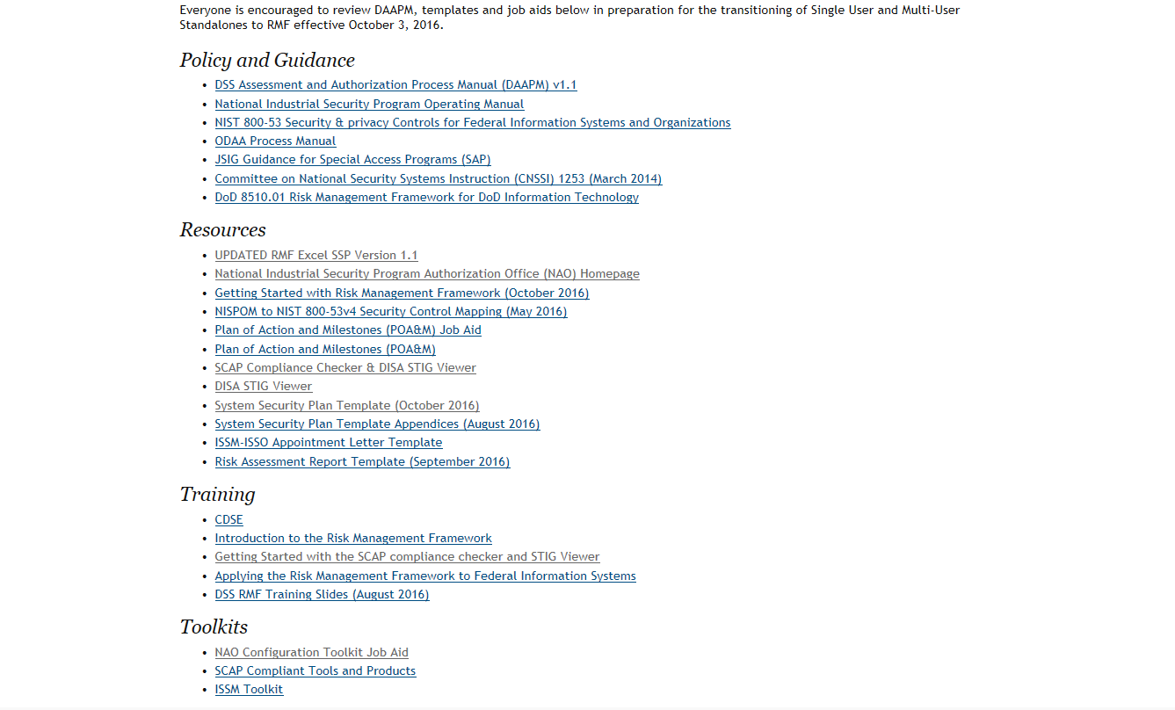
DSS RMF Information and Resources Web Page www.dss.mil/rmf

Slide 39
      Questions?
      Contact your local ISSP or visit http://www.dss.mil/rmf/.

